Slide 1
Big Data Driven Wildfire Risk Analysis and Prediction
Parineeta Patil

Slide 2
>$800 Million Loss
>100 Live loss
Can we mitigate the losses by predicting it in advance
Aim: Build an ML model which can learn the conditions that lead to a fire incident
Conditions:
Satellite images (RGB & FCC)
Topography
Weather
Human activity
In 2018 from Forest Fires in California alone

Slide 3
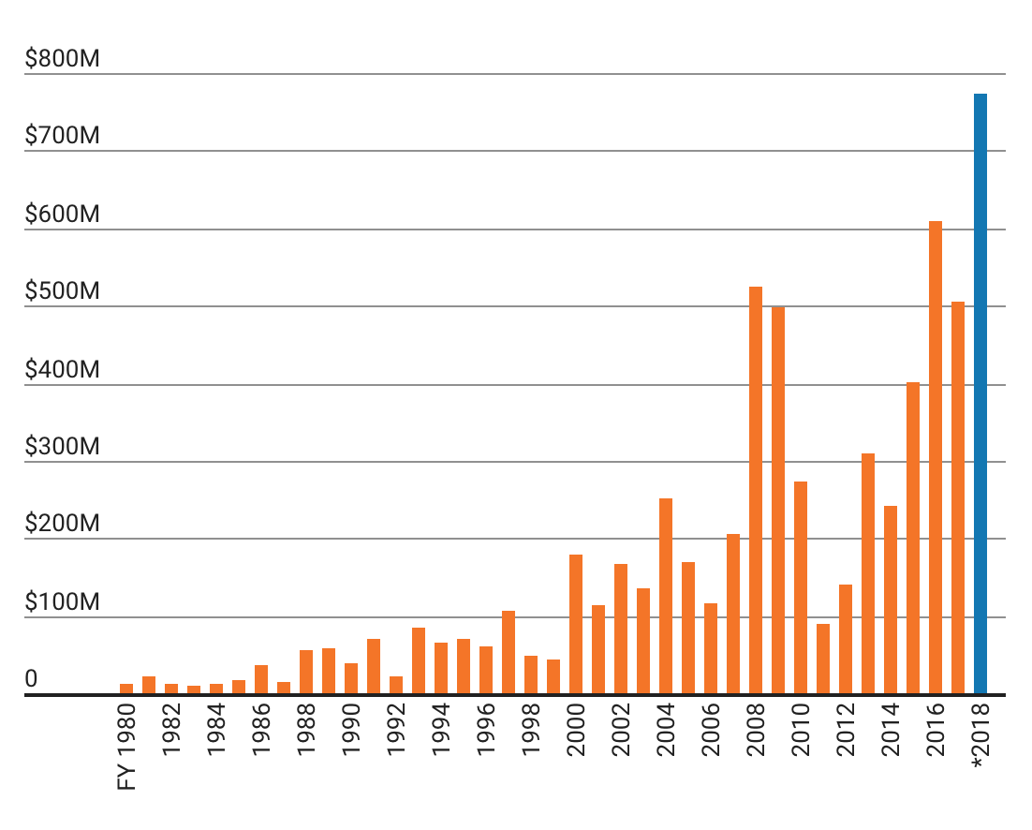
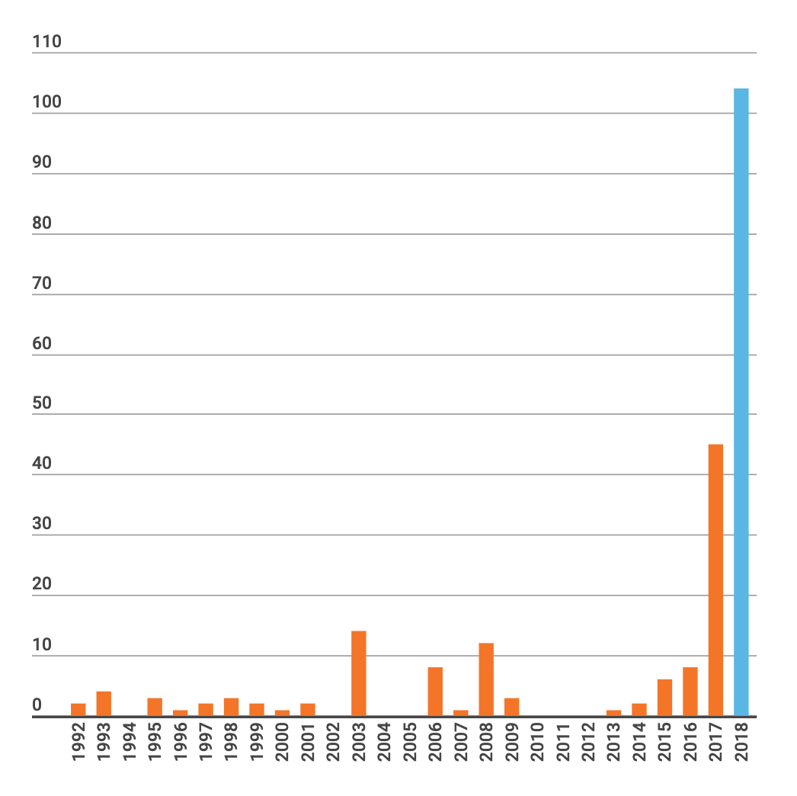
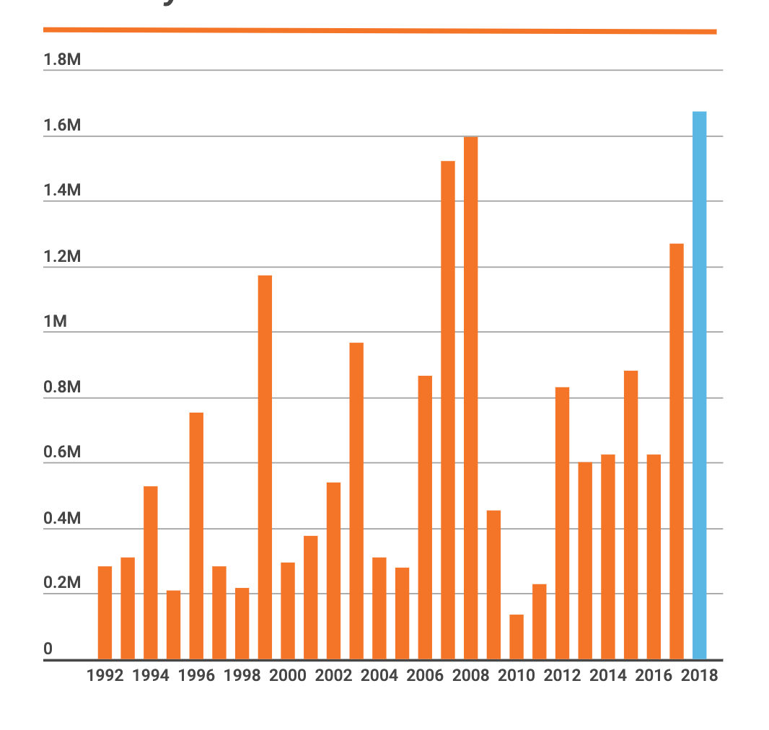
Fire history data Analysis
Soaring cost of wildfires
Wildfire deaths each year
Acres burned in California each year
Notes:
When we look the statistics of fire incidents happened over the history in california we can see that every year the soaring cost of wildfire increasing, death due to wildfire increases

Slide 4
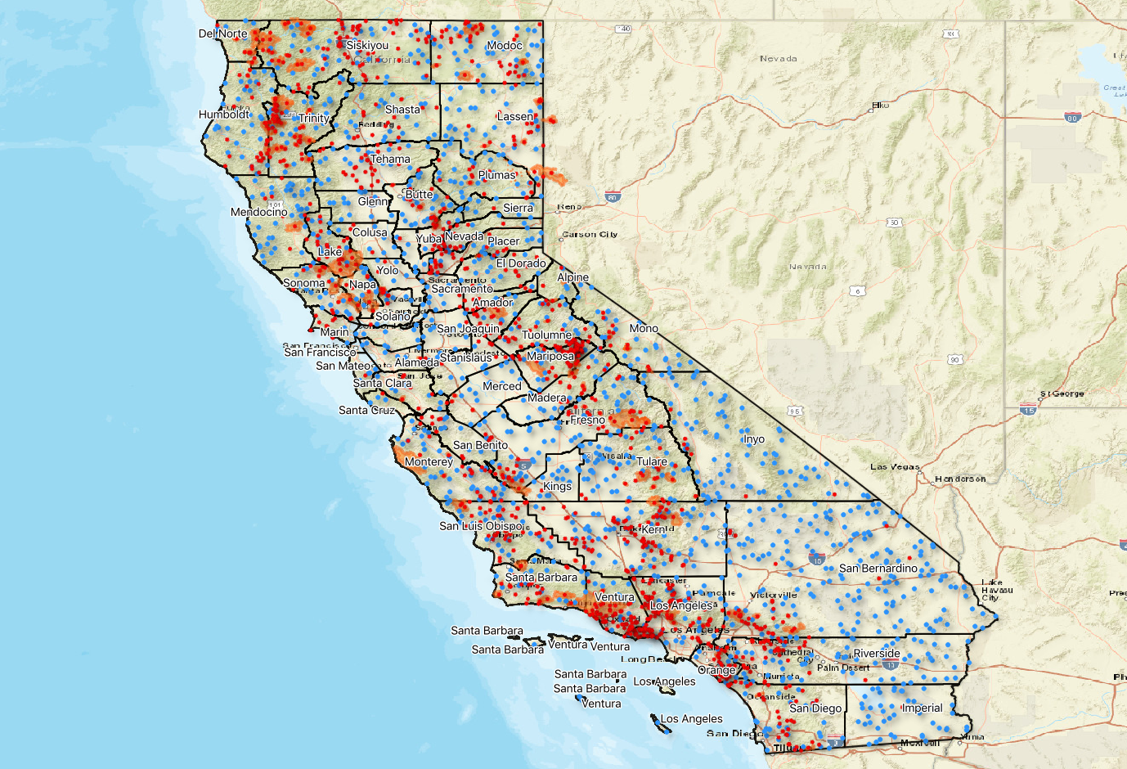
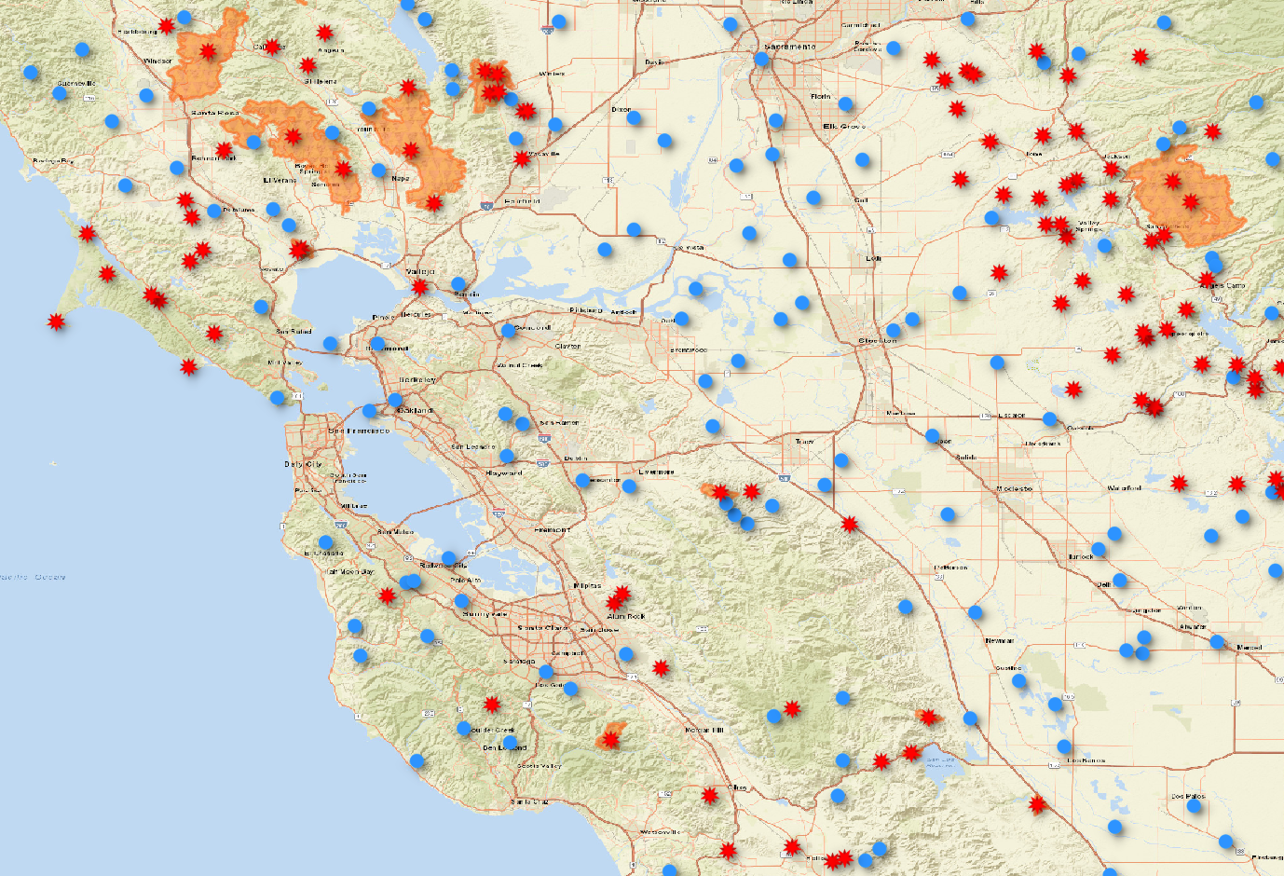
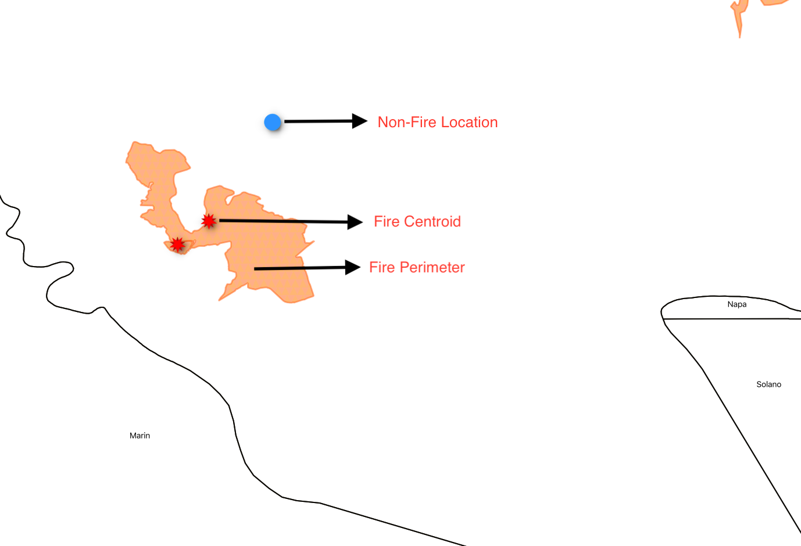
Training & Test Data Prep
B/w 2014 & 2017 , 937 Fires occurred in CA ⇒ 937 Fire Centroids
937 Fire Centroids (red) + 937 Randomly chosen Non-Fire points (blue)
⇒ 1874 Training set [ Location - Time Units (Lon, Lat, time) & Labels (Yes/No) ]
Notes:
From the fire history data we found that large numbers of fire occurred during the year 2014 and 2017 so we narrow done our study time period to this duration.We found that 937 fires occurred during this years and made our training data set. The fire history data from cal fire gives the information about shape of burned area and we consider the centroid of this area for analysis.

Slide 5
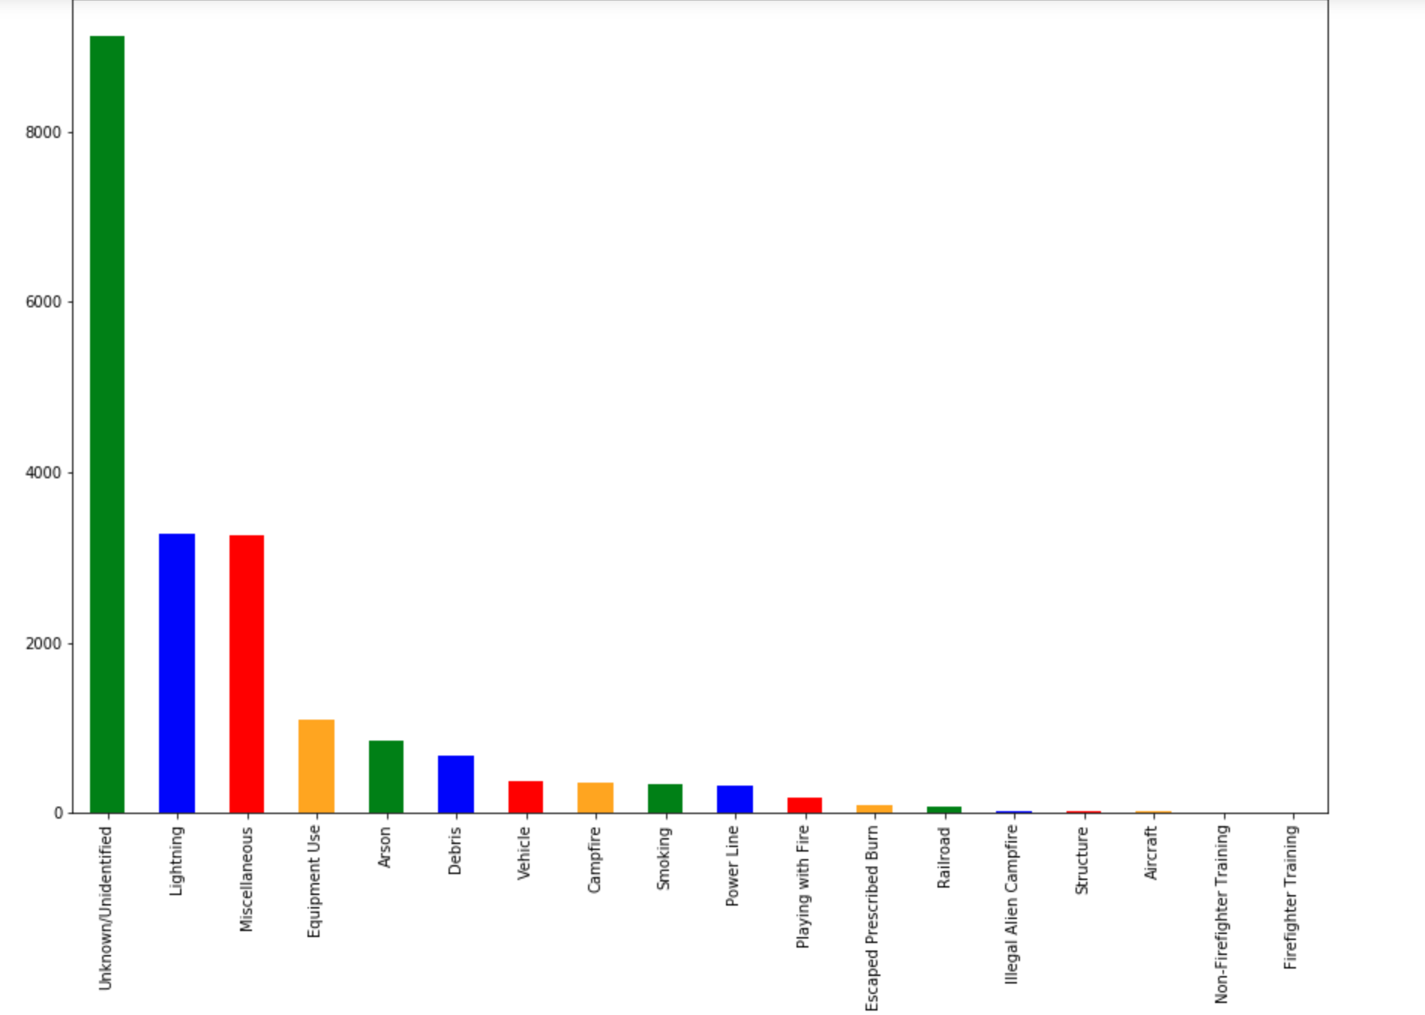
Fire Distribution by cause
Notes:
From this data we build the distribution of number of fire based on cause and most of the fire the causes are unfined and the second largest numbers occurred by lighting

Slide 6
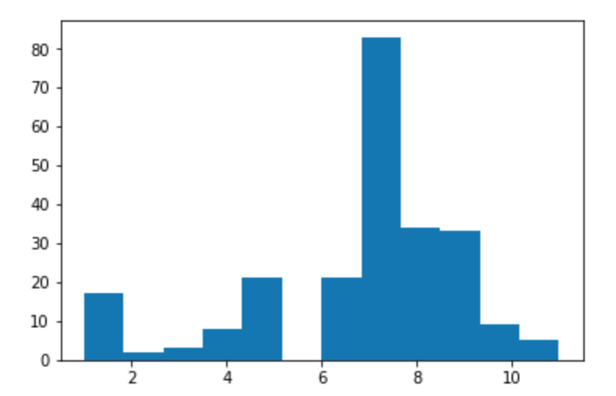
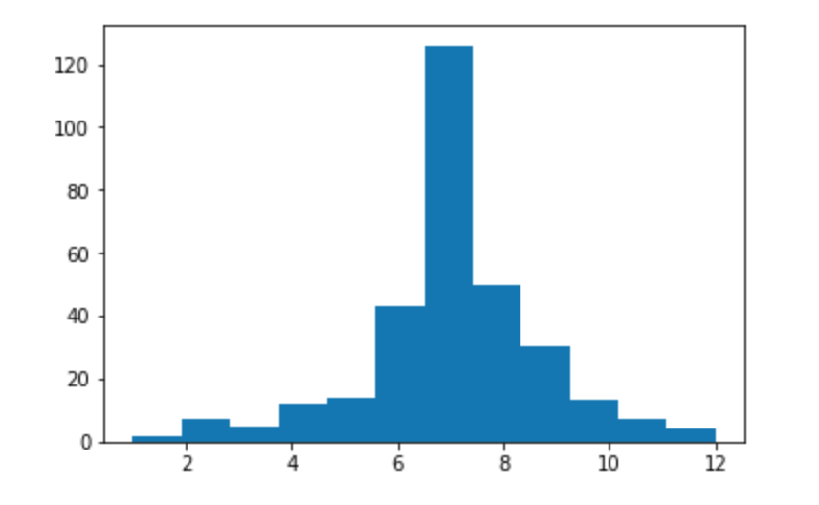
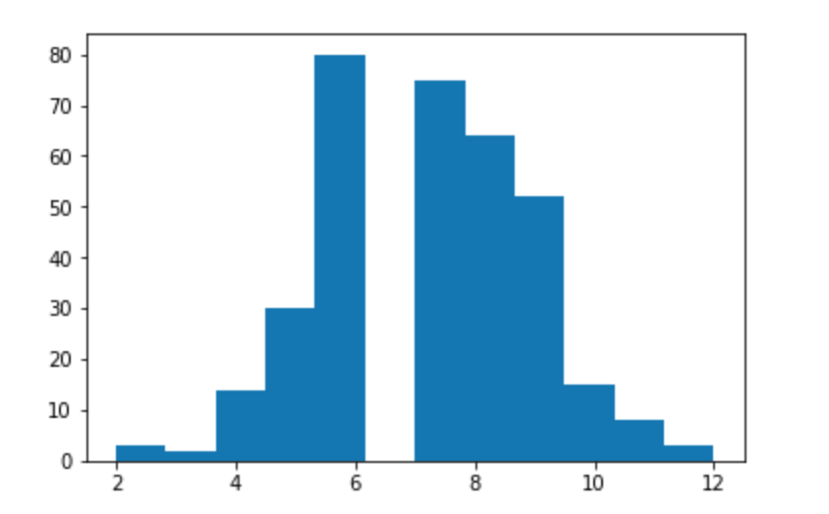
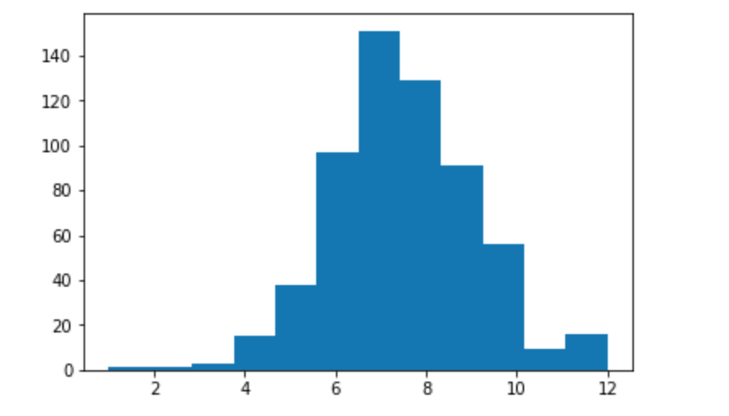
2015
2014
Distribution of fire over months
2016
2017
Notes:
By looking the histogram of distribution of fire over the month. We can see that most of the fire occurred during april to september.

Slide 7
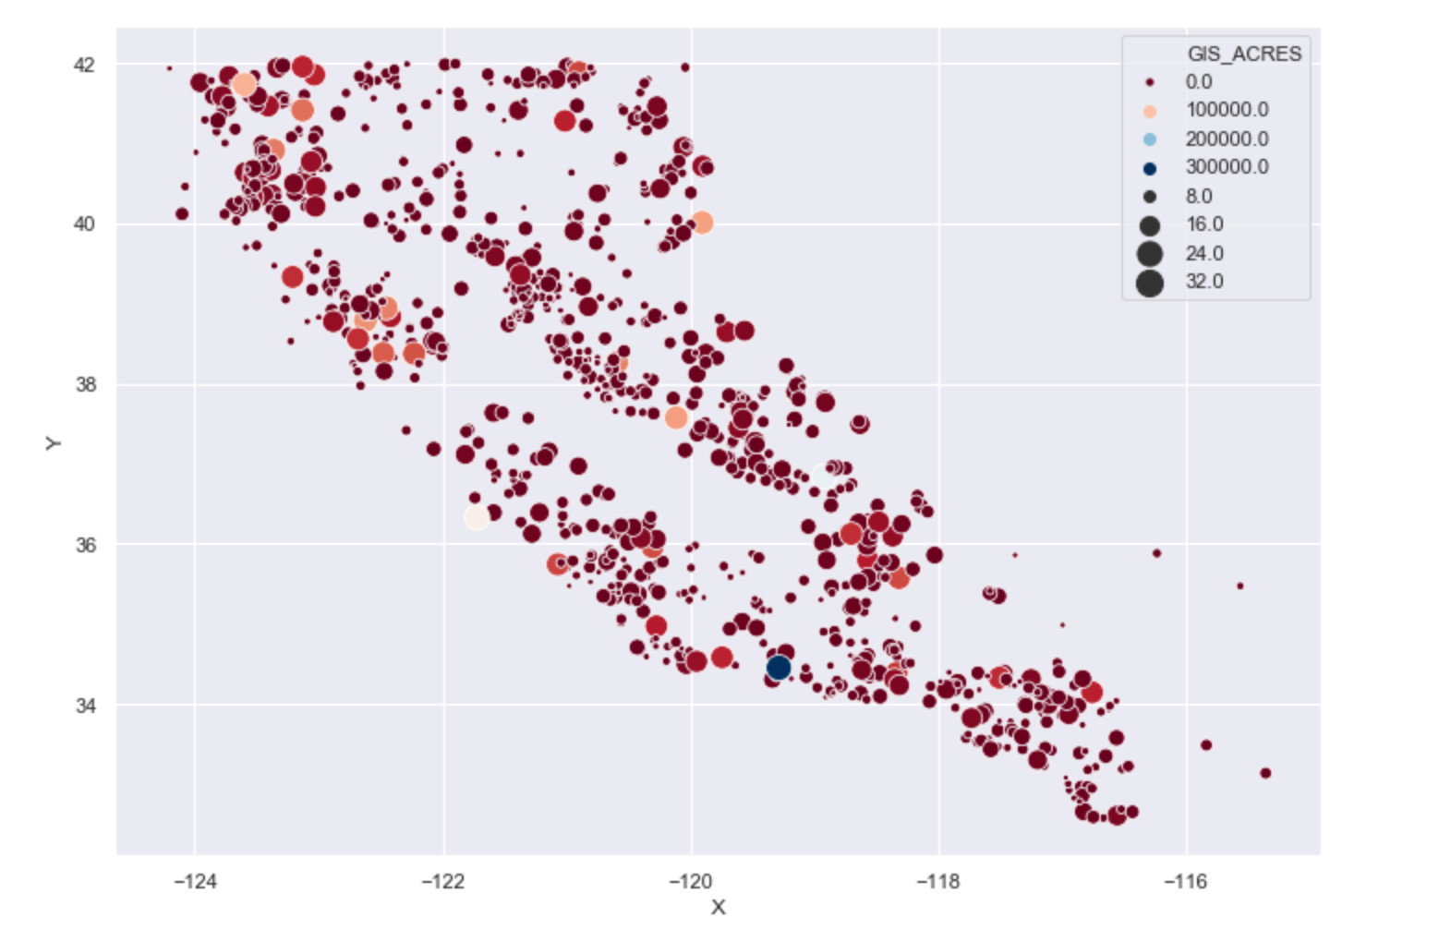
Fire Distribution by size
Notes:
This is the plot of distribution of fire by size so most of the largest fire concentrated on particular locations

Slide 8
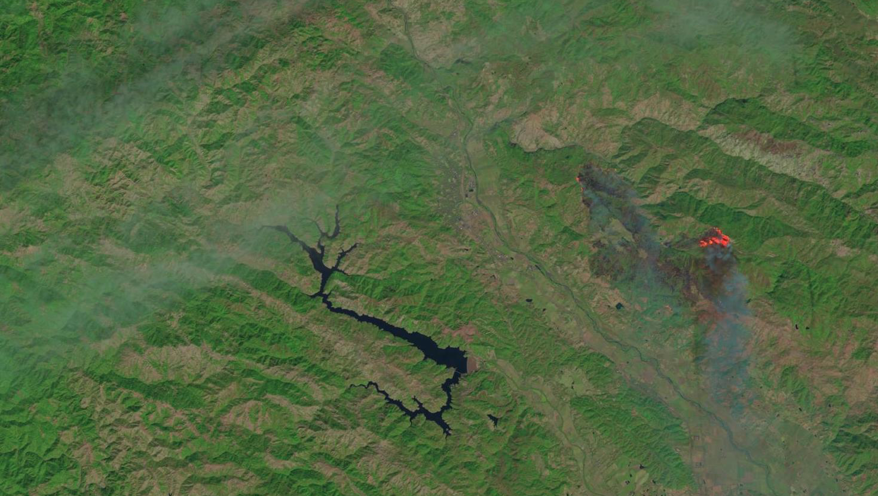
Satellite image
Notes:
After analyzing the history we were looking into the conditions for that first analysing the satellite image data

Slide 9
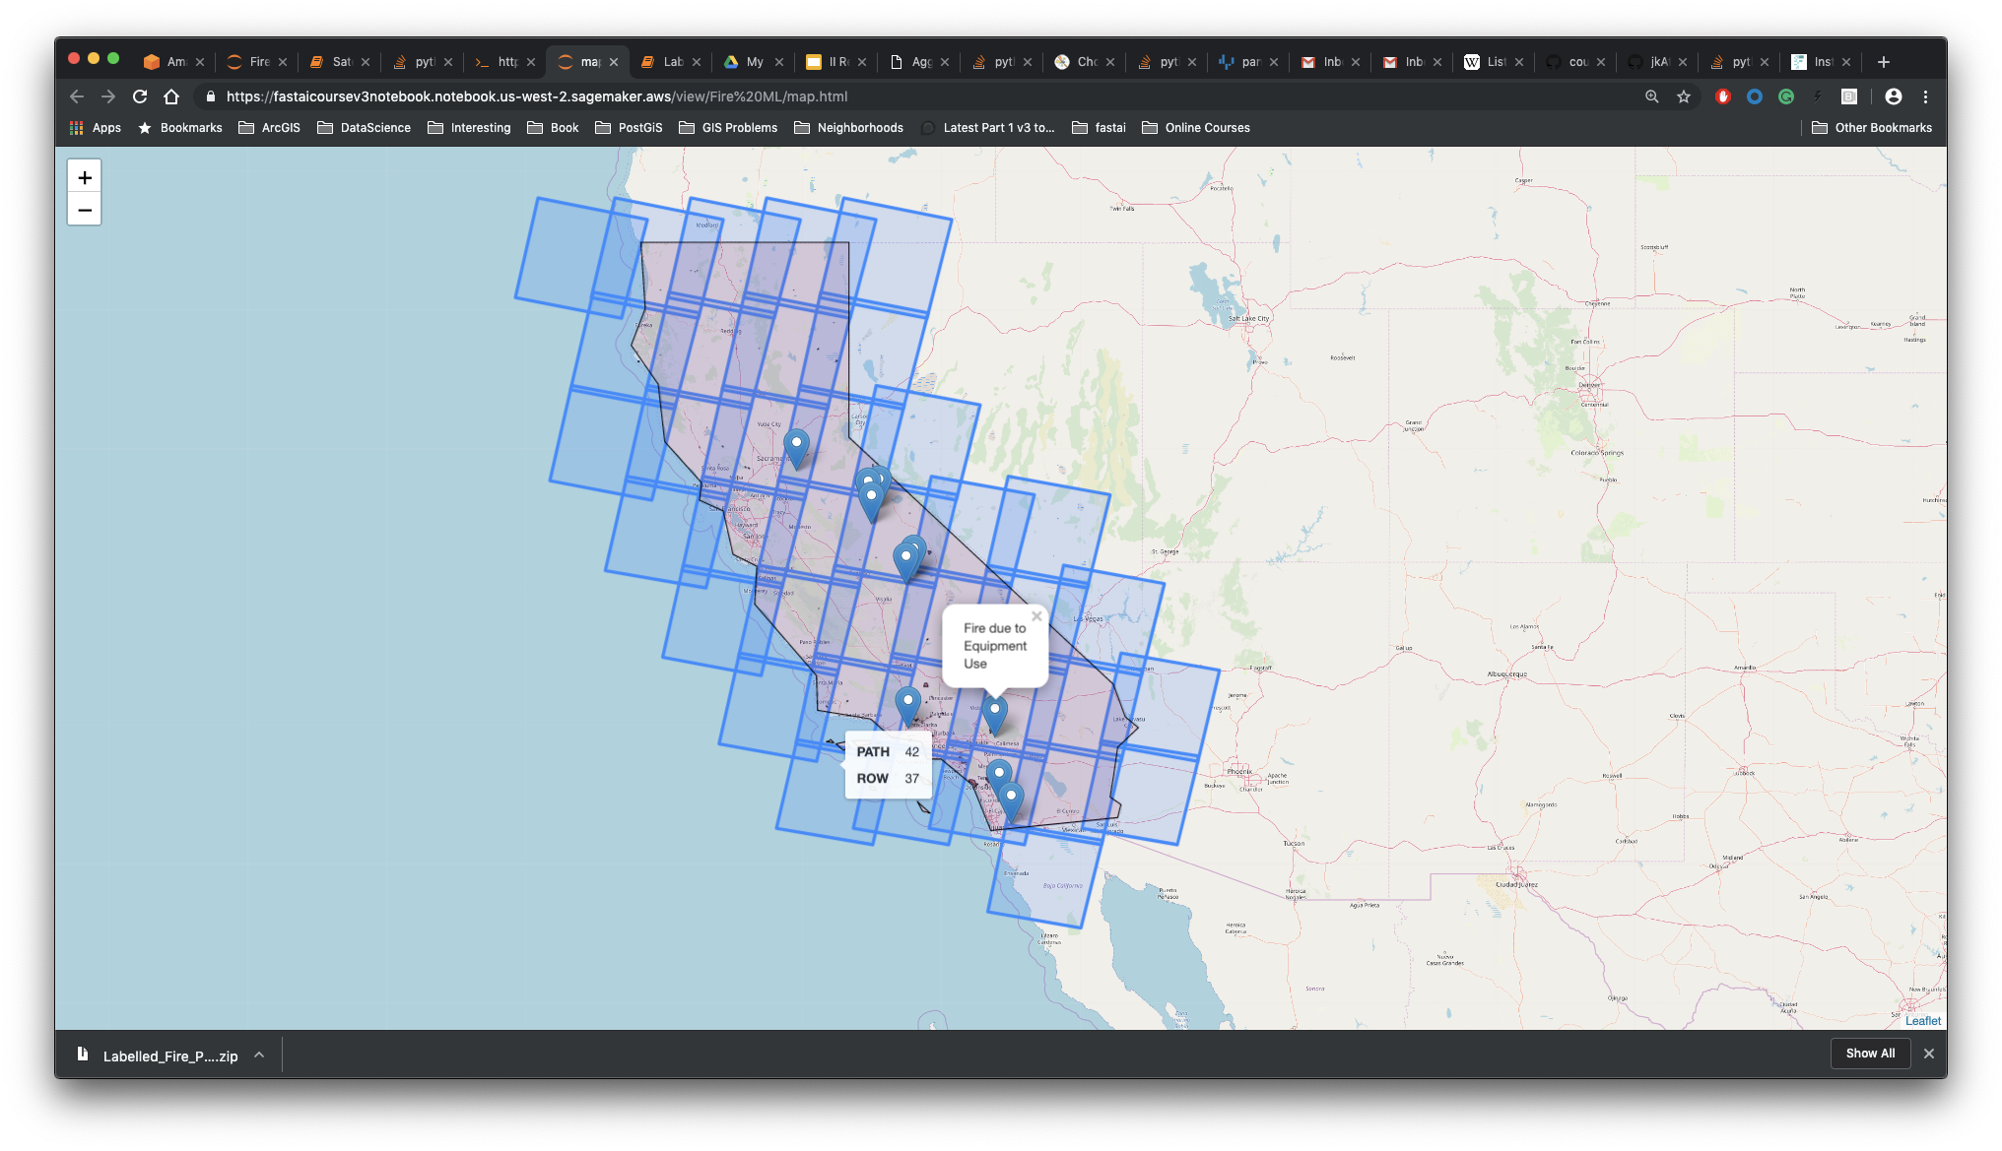
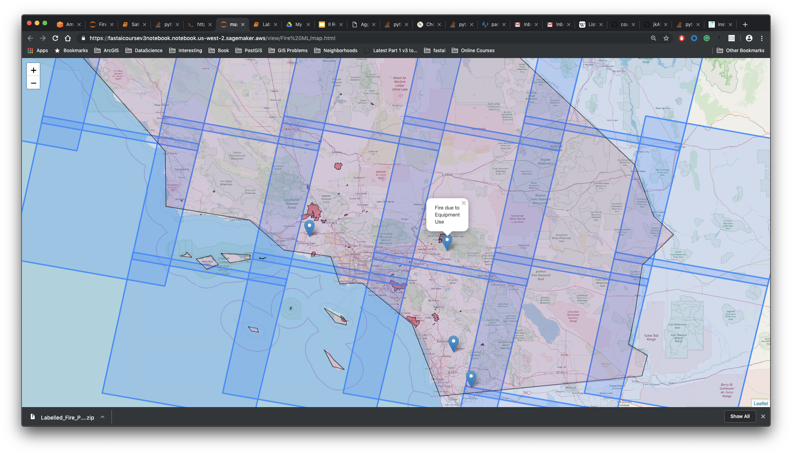
California ⇒ #38 Landsat-8 Tiles
Landsat Tile Schema
Notes:
Satellite image data taken from landsat . for landsat having tile schema so this this schema of california. From this tile we are selecting the best tile suitable for our fire location.

Slide 10
Selecting Landsat Scenes
Select the best scene
For each fire:
Select scene w/ least score
Use scene info to download data
3
Score the Scenes
Based on:
Cloud Coverage
Days to Fire
Distance from Center of Tile
2
Select Scenes from scene inventory
Tile intersecting Fire centroid
(Alarm Date - 16 days) > Scene Date > (Alarm Date - 1 day)
1
Notes:
For choosing that we are scoring each tile based on cloud coverage and accusation days close to fire alarm date and distance from centre of tile

Slide 11
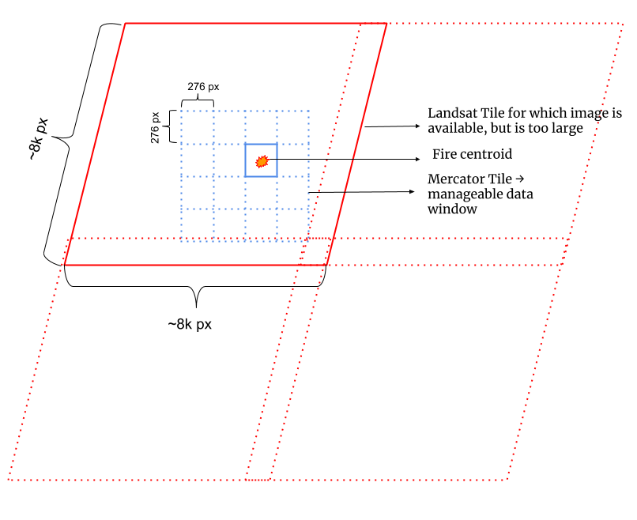
The data problem w/ Landsat Tiles
Notes:
Each band of landsat contain 8000* 8000 pixels so we are downsizing by using a google map schema called mercator tiles

Slide 12
Tile → Mercantile
I
II
III
IV
1 scene → 11 COGs
COG → Window pixels
Fire Pt → Mercantile windows
Window Pixels → Labeled Image
AWS Landsat repo provides Cloud Optimized GeoTIFFs (COGs)
One COG for each Red, Green, Blue, Near Infrared,.. Bands
Each COG → 8k px * 8k px; each px → 30m * 30m
For each Fire centroid find the Mercator Tile schema ⇒ Mercantile
Each Mercantile ⇒ 276px * 276px
Use the Mercantile Window to extract pixels
Save images w/ labels (Fire / Non Fire)
Notes:
1 sence of landsat contain 11 bands so we are downsizing each band using mercantile wind and getting 276*276 size images since we doing all this analysis in aws landser repo that provides this cloud optimized geotiff it increase our computational efficiency

Slide 13
Landsat Bands
Coastal
Blue
Green
Red
Near infrared
Coastal and aerosol Studies
Soil
Peak vegetation
Vegetation slope
Biomass content and shoreline
1
2
3
4
5
Reference: Barsi,J.A: Lee:Kvaran,G.Markham,B.L pedalty,J.A. The spectral response of the landsat-8 operational land imager.Remote sens 2014
Notes:
11 bands of landsat images carry each type of information. For example coastal band shows the coastal and areosol studies and blue show the soil green shows the peak vegitaion

Slide 14
SWIR
Panchromatic
Cirrus
Thermal IR-1
Thermal IR-2
Moisture content of soil.
Sharper image definition
Cloud distance
Soil moisture
Soil moisture
6
8
9
10
11
Reference: Barsi,J.A: Lee:Kvaran,G.Markham,B.L pedalty,J.A. The spectral response of the landsat-8 operational land imager.Remote sens 2014
Notes:
And thermal band show the soil moisture content

Slide 15
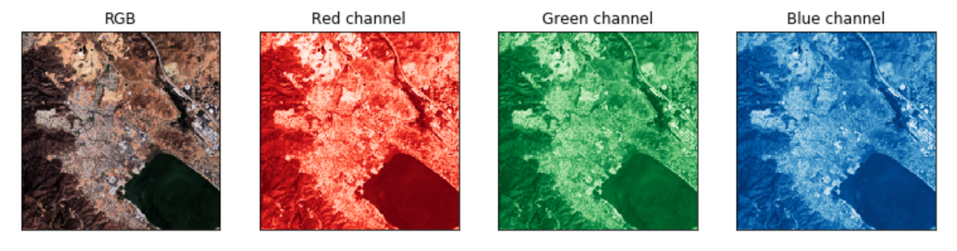
Making of RGB images
=
+
+
Notes:
Based on this band we are creating RGB images and False color composite images for analyis

Slide 16
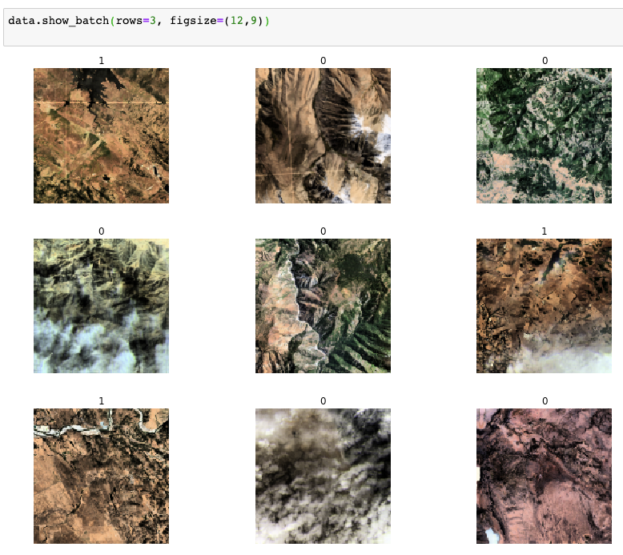
Training
1 - Image scene representing location at most 15 days before fire incident
0 - Image captured where no fire happens w/ in next 15 days
Notes:
So we are labelling the images scene close to fire incident as 1 and image captures when no fire happened marked as 0. These image we used for our modeling

Slide 17
Why CNN ?
Why RESENT 34 ?
Pre Trained model for Large size image
Converges Faster
Solve the vanishing gradient problem
High accuracy
Suited for Unstructured data
Automatic feature extractors
Applicable for Large dataset
Universal approximation
Effectively Downsample the image
Notes:
Here we are using convolutional neural network model. Why we use cnn for this satellite image analysis because it is suited for unstructured data such image . it has a main feature called automatic feature extractors so each layer of cnn model can extract each features from the data. It is best for analysing large dataset. It is universal approximation algorithm it can use for effectively downsizing the image. Different pre trained cnn model are available. Here we are using the model called RESENT 34 it is more suitable for large size image since we are using satellite image with 297 * 297 this model is suitable. And another advantage is it converge faster it can solve the vanishing gradient problem and also having high accuracy that other cnn models

Slide 18
CNN model with satellite image
Accuracy: 69 %
Fbeta : .88
Accuracy : 58 %:
Fbeta : 0.81
Accuracy: 30 %
Fbeta: 0.53
Satellite model 2
Satellite model 3
Satellite Model 1
Image classification: RGB image
Image classification: FCC image
FCC=RGB+ Near IF+ Thermal
Image segmentation: RGB image
Notes:
Based on resent34 algorithm we first trained a image segmentation model with RGB image got very low accuracy of 30 % then we performed a image classification and achieved a 58 % accuracy with RGB image. In landsat there are 11 bands and band such as near ifred and thermal band also capture some information about fire. So by combining RGB near if and thermal we are performed analysis and able to achive around 69 % accuracy

Slide 19
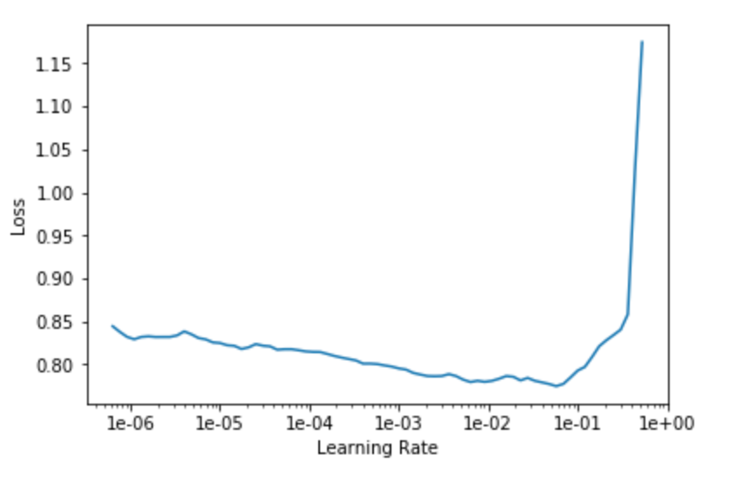
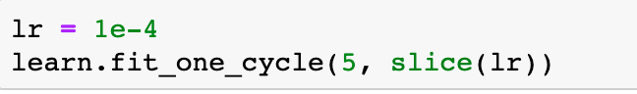
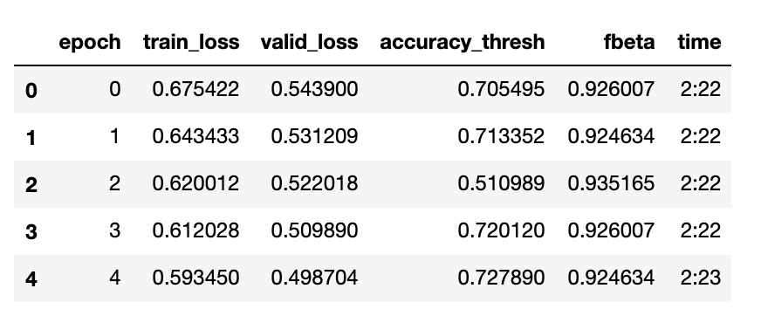
CNN cont...
Accuracy: 72 %
Fbeta: 0.92
Satellite Final model
Image classification: FCC image
FCC=RGB+ Near IF+ Thermal
Fine tuning : Discriminate learning rate
Notes:
If we are not set the correct learning rate then function may known converge or diverge and we won’t get correct optimized weight for each layers in our model. So here we can fine tune our model by using a technique called discriminate learning rate and slplity each combination of layers in different learning rate. So by this fine tuning we are able to achieve an accuracy of 72 %

Slide 20
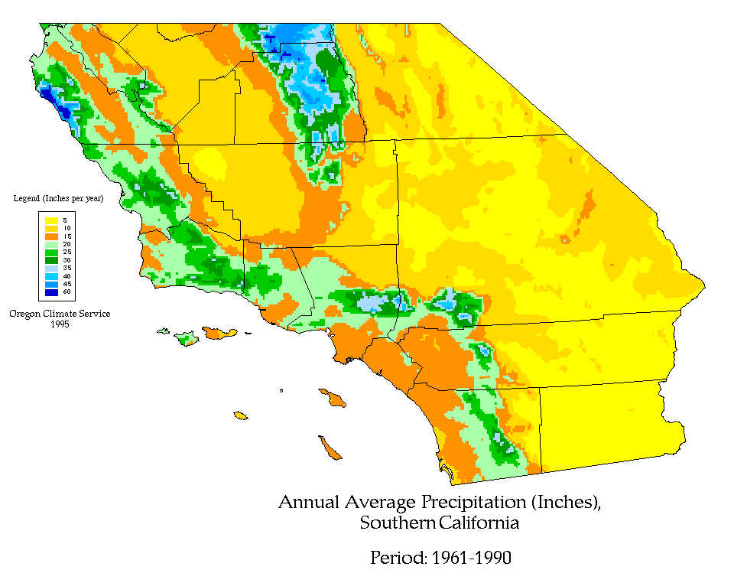
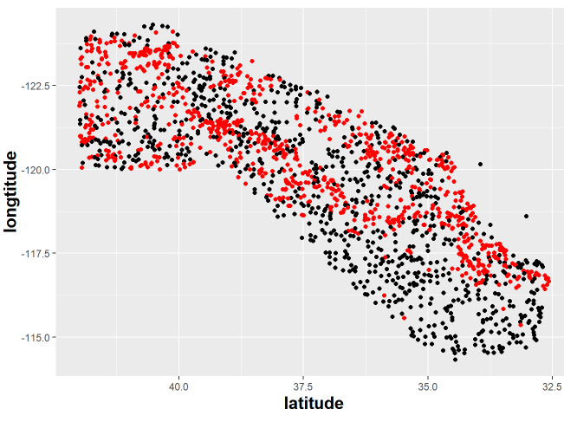
Weather

Slide 21
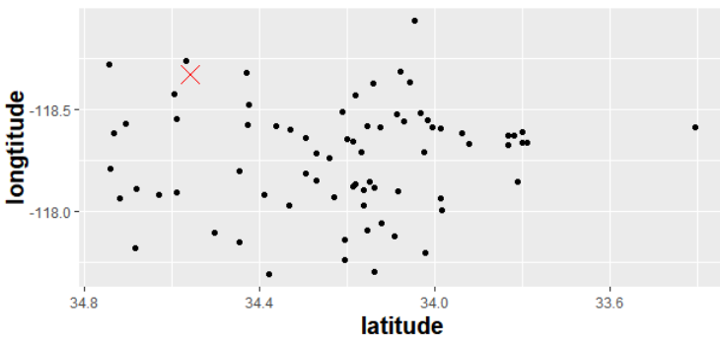
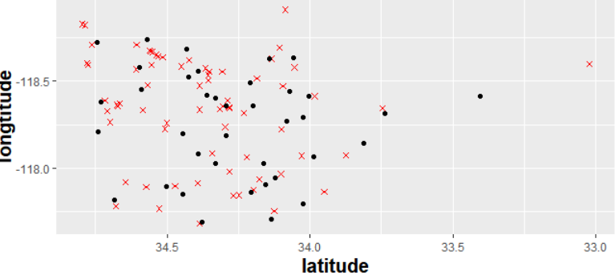
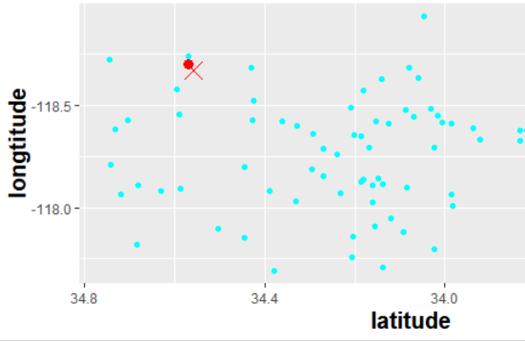
Data Processing
Step1: Selected the nearest weather point
Step2: Chose one station in
each burned area
After removing overlapped stations in each burned area, 745595 observations in dataset were reduced to 27020
133666 obs have fire and 13653 obs have no fire (58 counties)
Weather variables like average of wind, precipitation,temperature, evaporation and snow are utilized for analysis.

Slide 22
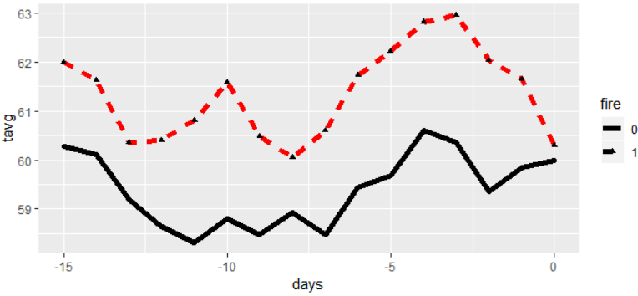
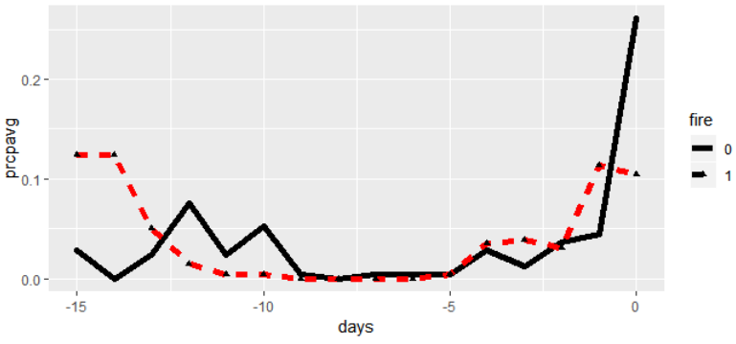
Temperature & Precipitation
Plots between days and tvag or prcp
KNN (accuracy: 55%)
Logistic Regression
log(p/(1-p))= 1.306+0.12prcp+0.29tavg
Possibility of fire will increase 33% when tavg increase one unit.
p-value(prcp>>0.05, tavg=0.01<0.05)
RMSE: 0.001
 | No fire | Fire
cluster1 | 17 | 21
cluster2 | 22 | 25

Slide 23
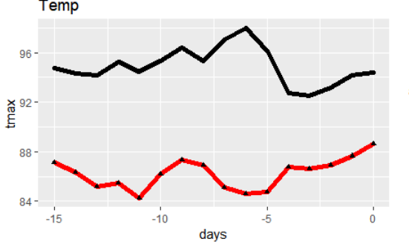
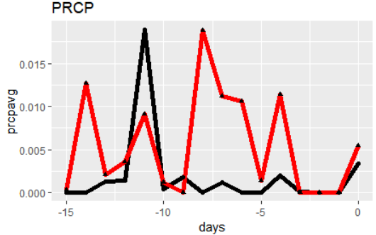
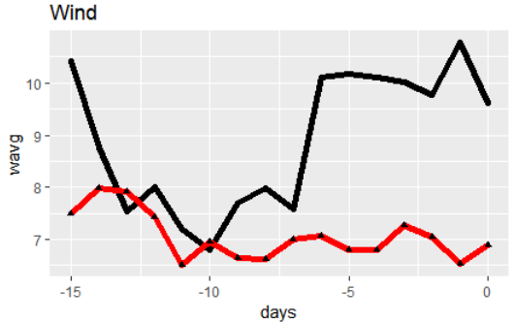
2. Temp & Precipitation & Wind
Plots by variables
1574 obs (fire:541, no fire:1033)
66 burned areas and 45 no fire areas
fire | tmax | wavg | prcpavg
0 | 94.89 | 8.9 | 0.00195
1 | 86.22366 | 7.05 | 0.0055

Slide 24
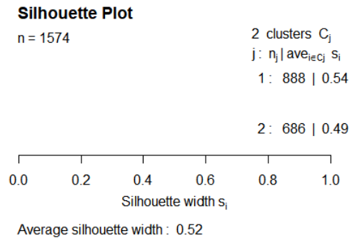
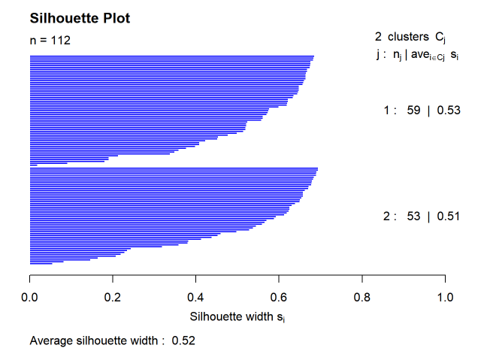
2. Temp & Precipitation & Wind
K-means
ARI: 0.067
Accuracy: 63%
 | No fire | Fire
cluster1 | 671 | 217
cluster2 | 362 | 324
 | CTYNAME | TAVG | TMAX | WAVG | PRCP
G1 | San Bernardino | 76 | 684. | 8,553 | 0.0001
G2 | Los Angeles | 66.4 | 79.8 | 7.9 | 0.007

Slide 25
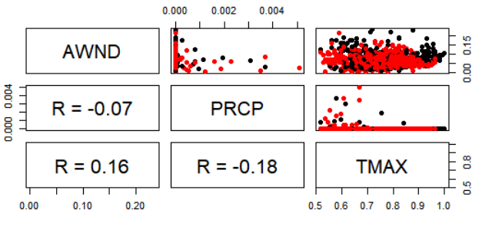
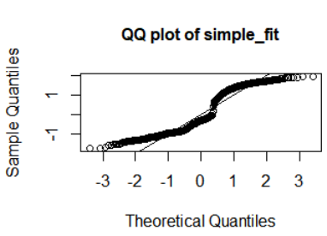
2. Temp & Precipitation & Wind
KNN (78%)
Correlation between variables
 | No fire | Fire
cluster1 | 54 | 7
cluster2 | 15 | 24
Logistic Regression
log(p/(1-p))= 2.54415 -2.24277wavg-20.25642tprcp-1.277tmax
Possibility of fire will increase 0.98% when tavg increase one unit.
p-value(prcp=0.642>>05, tmax=0.00<0.05, wagv<<0.05)
RMSE: 0.04

Slide 26
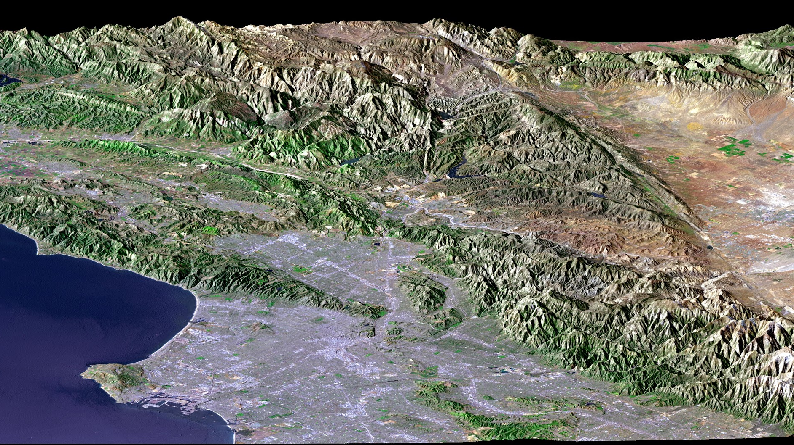
Terrain

Slide 27

Terrain Data Preparation:
Digital Elevation Models(DEM)
It is a raster representing the elevation of the ground and objects, such as buildings and trees, with pixel values in the images.
Taken from USGS earth explorer site
We obtained 2 DEMs which when merged together cover the entire area of California

Slide 28

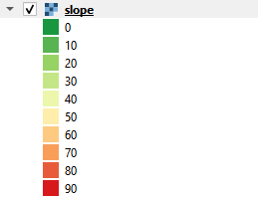
Terrain Data Preparation:
Processing the raw DEM to obtain the information about significant parameters
SLOPE:
Slope is the steepness or the degree of incline of a surface
Slope cannot be computed from the lidar points directly; one must first create either a raster or TIN surface
Slope for a particular location is computed as the maximum rate of change of elevation between that location and its surroundings
Slope can be expressed either in degrees or as a percentage

Slide 29

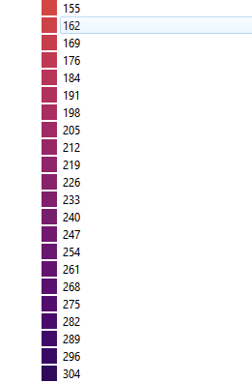
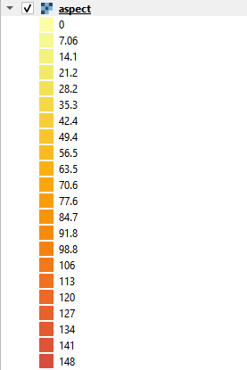
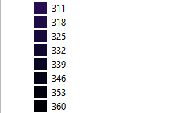
Terrain Data Preparation:
Processing the raw DEM to obtain the information about significant parameters
ASPECT:
Aspect is the orientation of slope, measured clockwise in degrees from 0 to 360, where :
0 is north-facing
90 is east-facing
180 is south-facing
270 is west-facing
It can be thought of as the slope direction

Slide 30
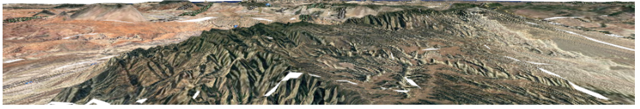
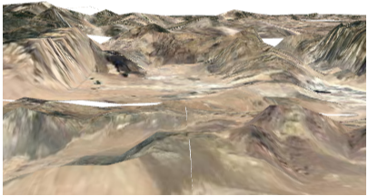
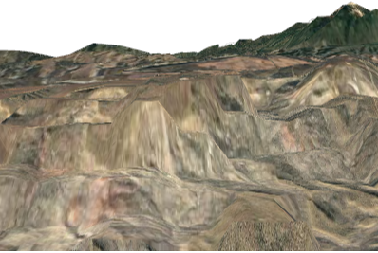
Terrain Data Preparation:
Processing the raw DEM to obtain the information about significant parameters
ELEVATION:
Each pixel in the Digital Elevation Model holds the elevation value.
Extract this feature from DEM.
We make use of the raster to point conversion feature in the ArcGIS which helps us in obtaining the Elevation Level associated with each point
Elevation values can also be visualized using 3D Visualization in QGIS

Slide 31
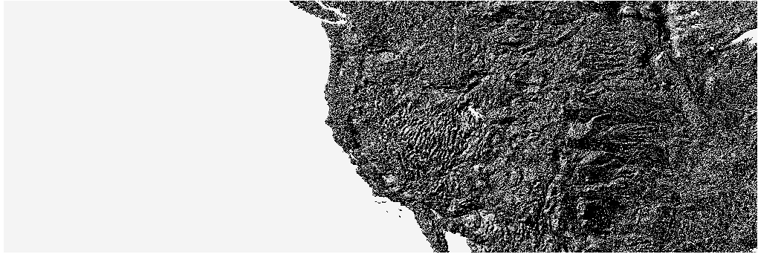
Terrain Data Preparation:
Processing the raw DEM to obtain the information about significant parameters
HILLSHADE:
Hillshading is a technique used to visualize terrain as shaded relief, illuminating it with a hypothetical light source
The illumination value for each raster cell is determined by its orientation to the light source, which is based on slope and aspect
By default, a grayscale color ramp is used to display a hillside elevation model
The following image displays an elevation model using the default hillside symbology.

Slide 32
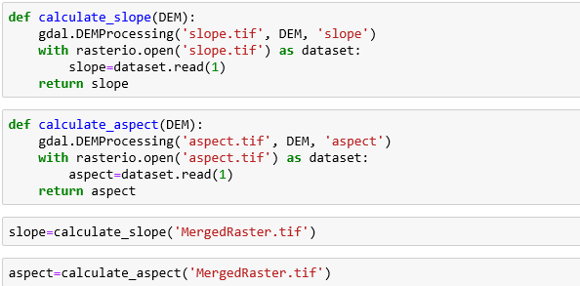
Terrain Data Preparation:
Processing the raw DEM to obtain the information about significant parameters
Extracting the Slope and aspect value from DEM to CSV:
Slope and aspect values present in the DEM are extracted with the help of python programming
The final dataset is prepared with the all the parameters of terrain is shown.

Slide 33
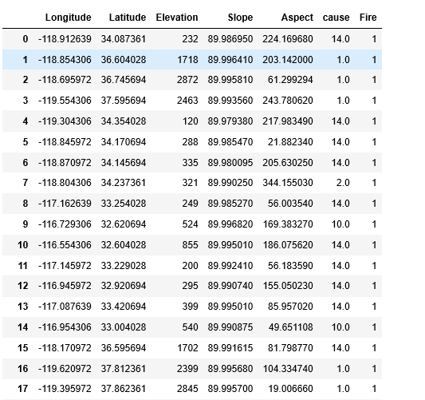
Terrain Data Preparation:
Processing the raw DEM to obtain the information about significant parameters
Extracting only the points needed for the study and labelling the points as Fire or No Fire
The CSV should contain the information about the points in study.
A KD tree is developed with our study locations as references and the corresponding data has been extracted from the terrain dataset
Since our reference file contains the fire labels too, we end up getting the complete dataset needed for our analysis

Slide 34
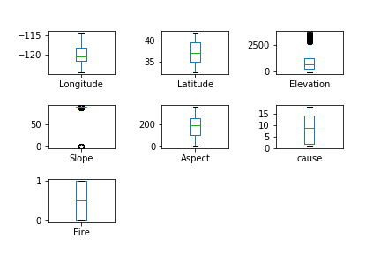
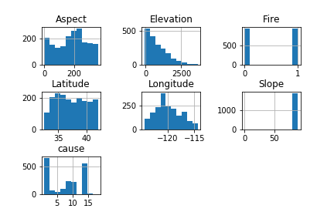
Terrain Data Feature and Label Comparisons and Visualization:
Visualizing the relationship between different features and label
BOX PLOT:
HISTOGRAM:

Slide 35
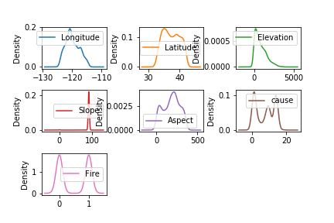
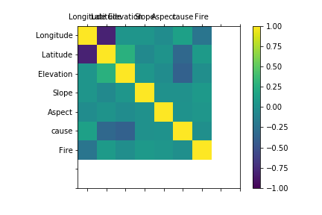
Terrain Data Feature and Label Comparisons and Visualization:
Visualizing the relationship between different features and label
DENSITY PLOT:
CORRELATION PLOT:

Slide 36

Terrain Data Feature and Label Comparisons and Visualization:
Visualizing the relationship between different features and label
SCATTER PLOT:

Slide 37
Terrain Data Modelling:
Model Used and Justification:
Model Used:
The Random Forest has been chosen to predict the occurence of wildfire using terrain data
MODEL JUSTIFICATION:
Random forest builds multiple decision trees and merges them together to get a more accurate and stable prediction
Random Forest adds additional randomness to the model, while growing the trees. Instead of searching for the most important feature while splitting a node, it searches for the best feature among a random subset of features. This results in a wide diversity that generally results in a better model
It is very easy to measure the relative importance of each feature on the prediction
Random Forests also provides facilities for autotuning the hyper parameter to improve the predictive power of the model

Slide 38


Terrain Data Modelling:
Random Forest Model Statistical Inference

Slide 39


Terrain Data Modelling:
Random Forest Model Randomized Search Cross Validation Statistical Inference and Accuracy

Slide 40


Terrain Data Modelling:
Random Forest-Identifying the features of importance and retaining 95% important information in model
Variable | Importance
Longitude | 0.27
Latitude | 0.19
Elevation | 0.18
Slope | 0.17
Aspect | 0.14
cause | 0.06

Slide 41

Terrain Data Modelling:
Random Forest-Running the model and doing Randomized Search CV for 95% important information
Accuracy: 79.19%
Mean AUC Score: 0.79829

Slide 42

Human
factors

Slide 43

Human factors in a nutshell
Stat credits- Morrison, P.H. 2007. Roads and Wildfires. Pacific Biodiversity Institute, Winthrop,
Washington. 40 p.

Slide 44
Data collection and preparation
GIS data of Solid waste management facilities, courtesy CalRecycle(Web address - https://www.calrecycle.ca.gov/illegaldump/)
GIS data of Railroad map from- http://www.dot.ca.gov/hq/tsip/gis/datalibrary/Metadata/Rail_13.html
Data realization and extraction done using ArcGIS by ESRI.

Slide 45


Preprocessing - Debris burning sites
Density map

Slide 46



Preprocessing - Railroads data
Centroids

Slide 47



Model selection and implementation
Model used - Logistic regression
Classification report
ROC graph
Accuracy

Slide 48


Final model: Ensembled Model
Combining Fire, Landscape, Weather and Human activities data using concatenation method of KDtree.
Dropping off unwanted input parameters from the combined data file for modelling.

Slide 49


Merging of different aspects of wildfire

Slide 50




Model prediction accuracy
Final Accuracy

Slide 51
Future scope
By collecting the historical time window data modeling fire spreading pattern
Classification of fire based on severity
Rasterization of weather and terrain data can be useful for predicting fire more precisely
Analysing satellite images by considering all 11 bands
Inclusion of Camping sites and Power transmission line datasets under Human activity causes

Slide 52
Reference
Barsi,J.A: Lee:Kvaran,G.Markham,B.L pedalty,J.A. The spectral response of the landsat-8 operational land imager.Remote sens 2014
G. E. Sakr, I. H. Elhajj, G. Mitri and U. C. Wejinya, "Artificial intelligence for forest fire prediction," 2010 IEEE/ASME International Conference on Advanced Intelligent Mechatronics, Montreal, ON, 2010, pp. 1311-1316. doi: 10.1109/AIM.2010.5695809
Youssef et al “Prediction of forest fires using artificial neural networks”,2010
Marcos Rodrigues, Juan de la Riva,,”An insight into machine-learning algorithms to model human-caused wildfire occurrence,Environmental Modelling & Software” Volume 57, 2014, Pages 192-201,ISSN 1364-8152,
Stojanova, Daniela & Panov, Pance & Kobler, Andrej & Džeroski, Sašo & Taškova, Katerina. (2006). Learning to predict forest fires with different data mining techniques.
Cortez, Paulo & Morais, A. (2007). A Data Mining Approach to Predict Forest Fires using Meteorological Data.

Slide 53

Thank you for your time.
Questions are welcome!

